Slide 1
MINI PROJECT

Slide 2
Group members
AISWARYA S
AYANA ELDHOSE
KEERTHY GOPINATH
LIYA ANIL

Slide 3
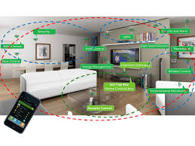
SMART HOME
Smart home

Slide 4
OBJECTIVES
Objective of the project is to control home appliances from remote area.
There are many methods for controlling devices but they are expensive.
So here we use all basic components to make our project easier.

Slide 5
INTRODUCTION
The concept of smart home is an emerging issue in the modern technology dependent society.
It is used to control household electronic appliances.
Cellular technology is a potential solution for remote controlling activities.
GSM-SMS technology can be used to control household appliances from remote places.

Slide 6
EXISTING SYSTEM
Controlling household appliances through computer can be possible.
There are many home wireless based devices for controlling but they are expensive.

Slide 7
DISADVANTAGES
Maximum power and time utilisation.
Expensive.
Difficult to manage.
It cannot fulfill the current demand.

Slide 8
PROPOSED SYSTEM
They are widely used to control household electronic appliances.
Here we use all basic components such as SIM,GSM etc.
Coordinate appliances and other devices using SMS.
Effectively receive and transmit data via SMS.

Slide 9
ADVANTAGES
Simple and easy to access.
Portable.
Access from remote area.
Low power consumption.
Taking measure to reduce electricity bill.

Slide 10
SOFTWARE USED
Embedded C
Proteus software
Khasama software

Slide 11
HARDWARE USED
Atmega32
GSM module
LCD
Relay
Voltage level converter
Driving circuit
Power supply
Oscillator circuit

Slide 12
:
Block Diagram
LCD
Micro controller
MAX232
Oscillator circuit
Reset logic
GSM module
Relay
Relay
Relay
Power supply
Water pump
Light
Fan

Slide 13
BLOCK DIAGRAM EXPLANATION
Micro controller
Heart of the project.
A microcontroller is a small computer on a single integrated circuit
Lcd
Liquid display is a flat panel display.
They are common in consumer devices.

Slide 14
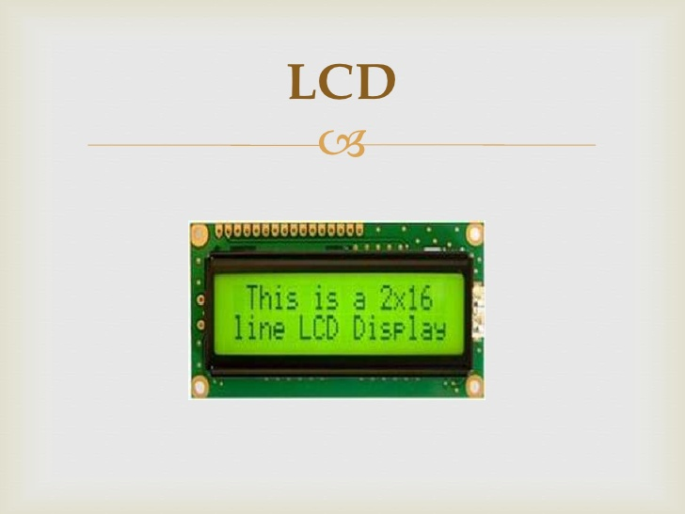
Crystal oscillator
Is an electronic oscillator circuit .
It uses the mechanical resonance of a vibrating crystal of a piezo electric material
to create an electrical signal with very precise frequenecy.

Slide 15
Driving unit
It is used control various action like turning off or
on different devices.
Reset
Reset is used for putting micro controller in known condition
Max 232
It is an IC.
It convert signals from an rs232 serial port to signal suitable for use in TTL compactable logic circuit.

Slide 16
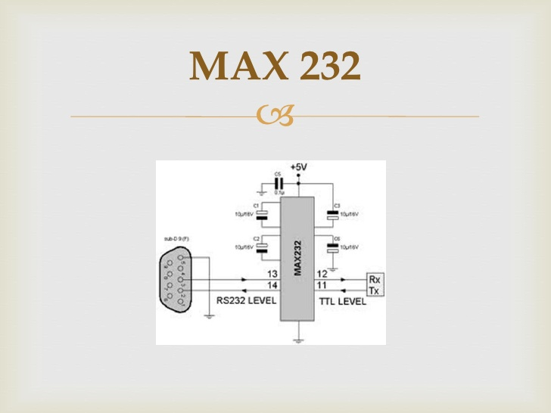
GSM
Is a specialised type of modem which accept a SIM card and it operate like a mobile phone.
It is a dedicated modem device with a serial USB on it.
GSM support an extended AT command set.

Slide 17
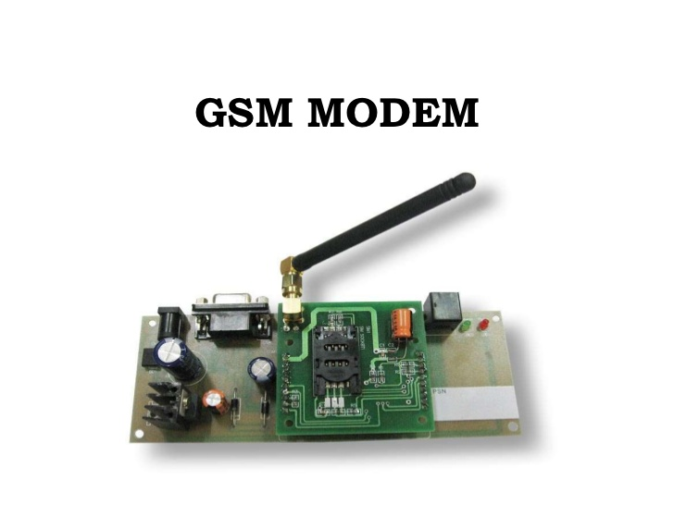

Slide 18
GSM
Is a specialised type of modem which accept a SIM card and it operate like a
mobile phone
It is a dedicated modem device with a serial USB on it.
GSM support an extended AT command set.

Slide 19
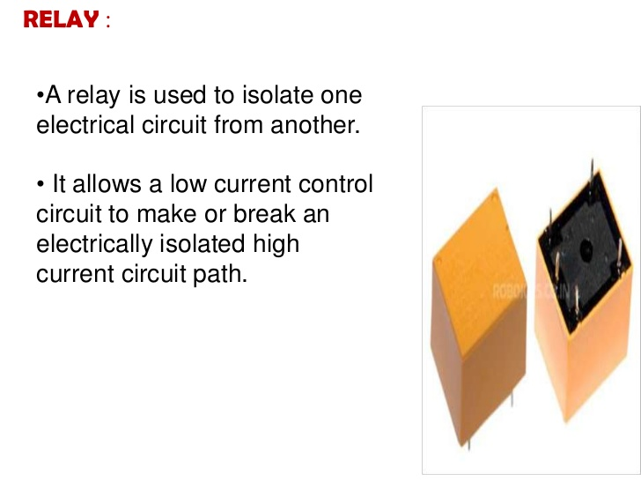
Power supply
Power supply is a device that supplies electric power to an electrical load.
A regulated power supply is one that controls output voltapege or current

Slide 20
5vdc
Regulated power supply
5vdc
5V
Step down transformer
Rectifier
Filter
Regulator

Slide 21
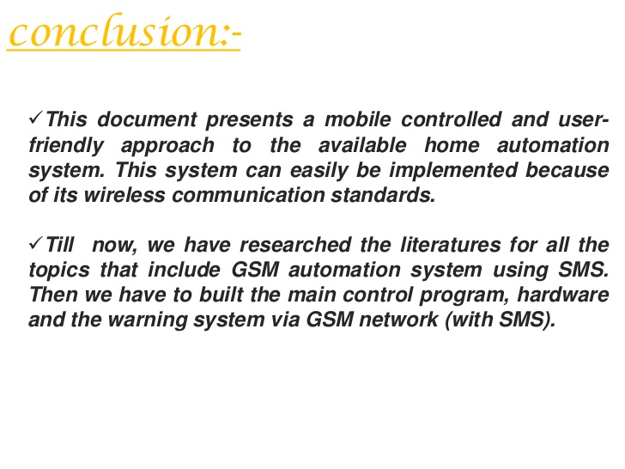

Slide 22
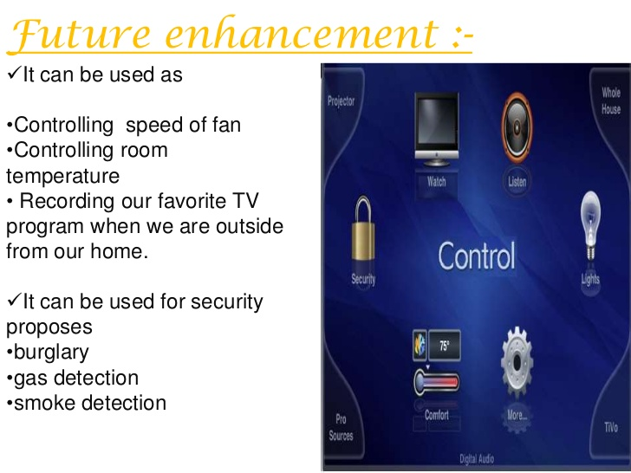

Slide 23
Thank you

